Slide 1

Computer Organization & Architecture
PBCST404
MODULE 1
DHANYA PG
Asst. Professor, cse

Slide 2
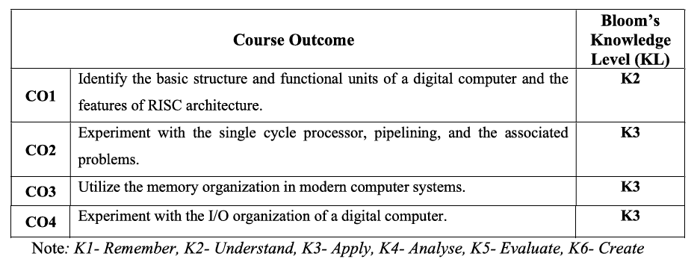
COURSE OUTCOME

Slide 3
MODULE 1 :
Basic Structure of computers :– Functional units - Basic operational concepts; Memory map; Endianness.
CISC vs RISC architectures:- RISC Introduction - Assembly Language, Assembler directives, Assembling.
Programming concepts - Program flow, Branching, Conditional statements, Loops, Arrays, Function calls; Instruction execution cycle.
Machine language - Instructions, addressing modes, Stored program concept. Evolution of the RISC Architecture.

Slide 4
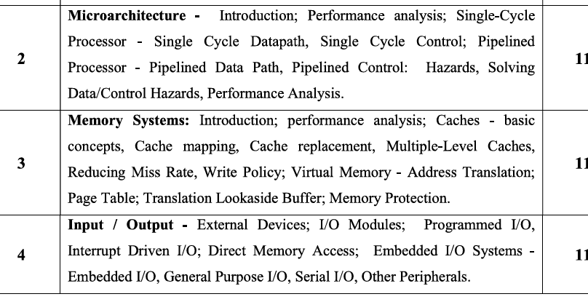

Slide 5
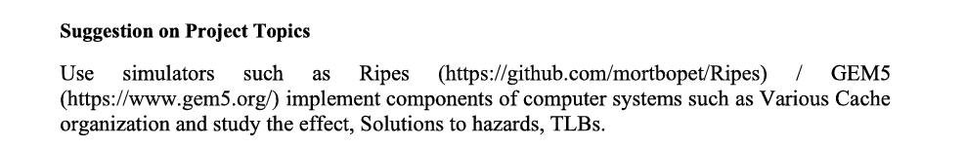
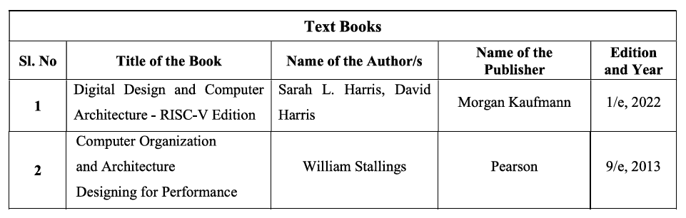

Slide 6
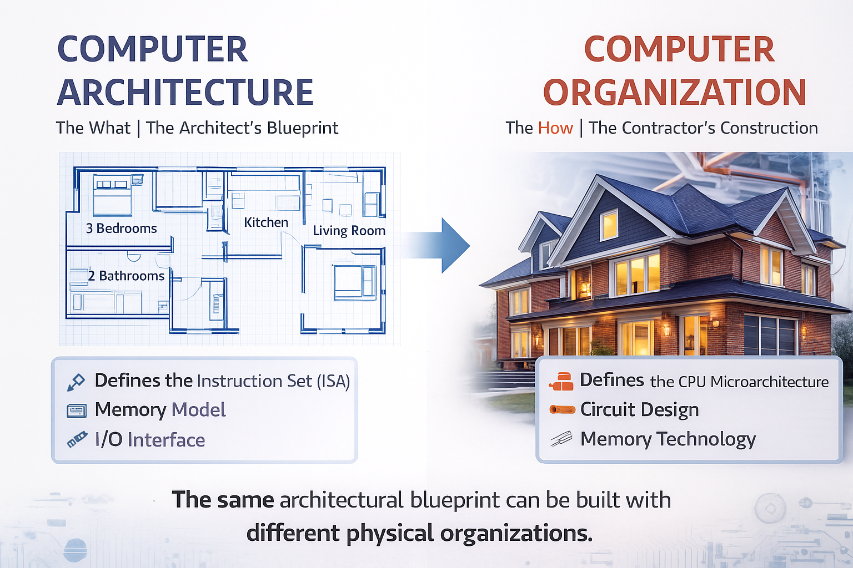
The Analogy: Building a House

Slide 7
Computer Architecture is the what: The conceptual design and functional behavior of the computer system as seen by the programmer. It's the "Architect's Blueprint."
Computer Organization is the how: The physical implementation and operational units that realize the architectural specifications. It's the "Contractor's Construction.“
The Analogy: Building a House
Architecture (The Blueprint):
  "The house will have 3 bedrooms, 2 bathrooms, a kitchen, and a living room."
  It specifies what the features are, not how to build them.
Organization (The Construction):
  "The walls will be made of brick, the pipes will be copper, and the electrical wiring will run through the ceiling."
  It specifies how to implement the blueprint with physical materials.

Slide 8
COMPUTER ARCHITECTURE
Computer architecture refers to those attributes of a system visible to a programmer or, those attributes that have a direct impact on the logical execution of a program.
computer architecture = instruction set architecture (ISA) .
The ISA defines
Instruction formats, instruction opcodes, registers, instruction and data memory
The effect of executed instructions on the registers and memory and
An algorithm for controlling instruction execution.

Slide 9
COMPUTER ORGANIZATION
Computer organization refers to the operational units and their interconnections that realize the architectural specifications.
Examples of architectural attributes include the
instruction set, the number of bits used to represent various data types (e.g., numbers, characters), I/O mechanisms, and techniques for addressing memory.
Organizational attributes include those
hardware details transparent to the programmer, such as control signals; interfaces between the computer and peripherals; and the memory technology used.

Slide 10
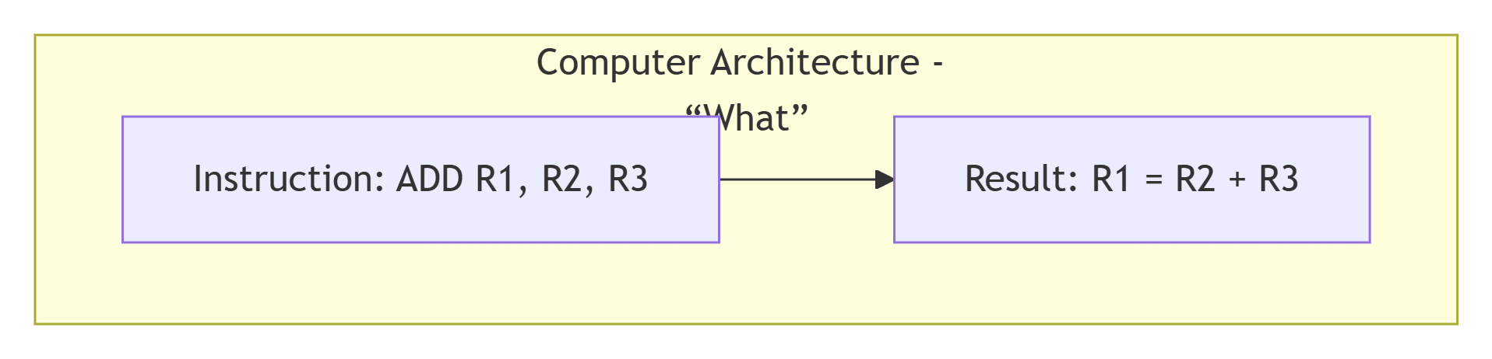
Eg: ADD R1, R2, R3 (which means R1 = R2 + R3)
Level 1: Computer Architecture View (The Programmer's View)
The instruction set is defined (ADD).
The registers are defined (R1, R2, R3).
The functionality is defined (the result of R2 + R3 is placed in R1).

Slide 11
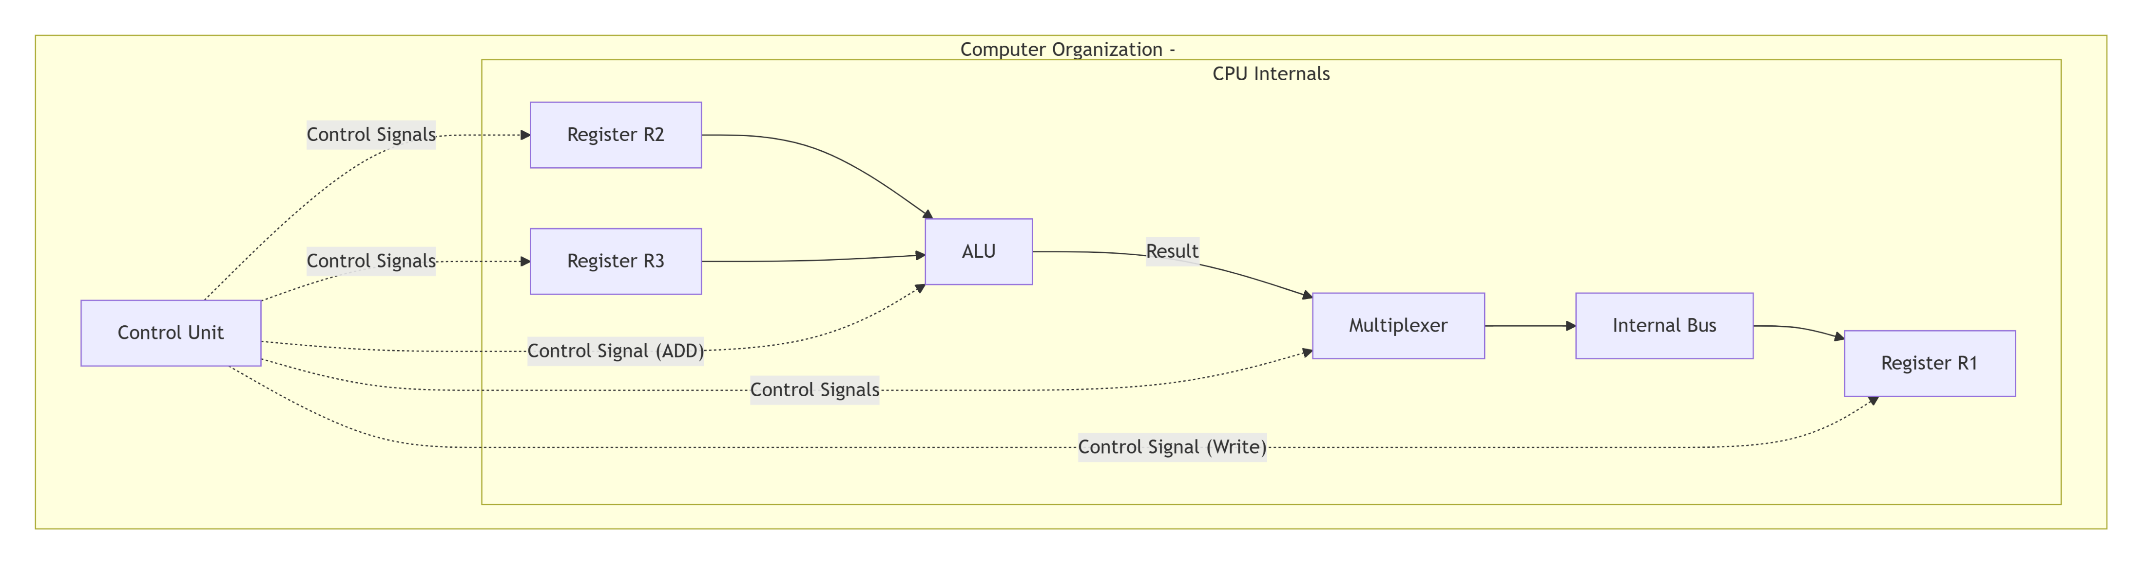
Level 2: Computer Organization View (The Engineer's View)
This is a low-level, physical diagram showing the data path and control signals needed to execute the instruction.
The physical components (ALU, Registers, Bus, Multiplexer, Control Unit).
The data flow between components (paths of the arrows).
The control signals (dotted lines) from the Control Unit that tell each component what to do and when.

Slide 13
Control Unit activates: It decodes the ADD instruction and sends out a series of control signals.
Read Operands: Signals tell registers R2 and R3 to place their values onto the inputs of the ALU.
Perform Operation: A signal tells the ALU to perform the ADD operation.
Route Result: A signal tells the Multiplexer to select the ALU's result and place it on the internal bus.
Write Back: A signal tells register R1 to latch the value from the bus and store it.

Slide 14
Structure and Function
A computer is a complex system; contemporary computers contain millions of elementary electronic components.
A hierarchical system is a set of interrelated subsystems; each subsystem may, in turn, contain lower-level subsystems, until we reach some lowest level of elementary subsystem.
At each level, the system consists of a set of components and their interrelationships.
The behavior at each level depends only on a simplified, abstracted characterization of the system at the next lower level.
At each level, the designer is concerned with structure and function:
Structure: The way in which the components are interrelated.
Function: The operation of each individual component as part of the structure.

Slide 15
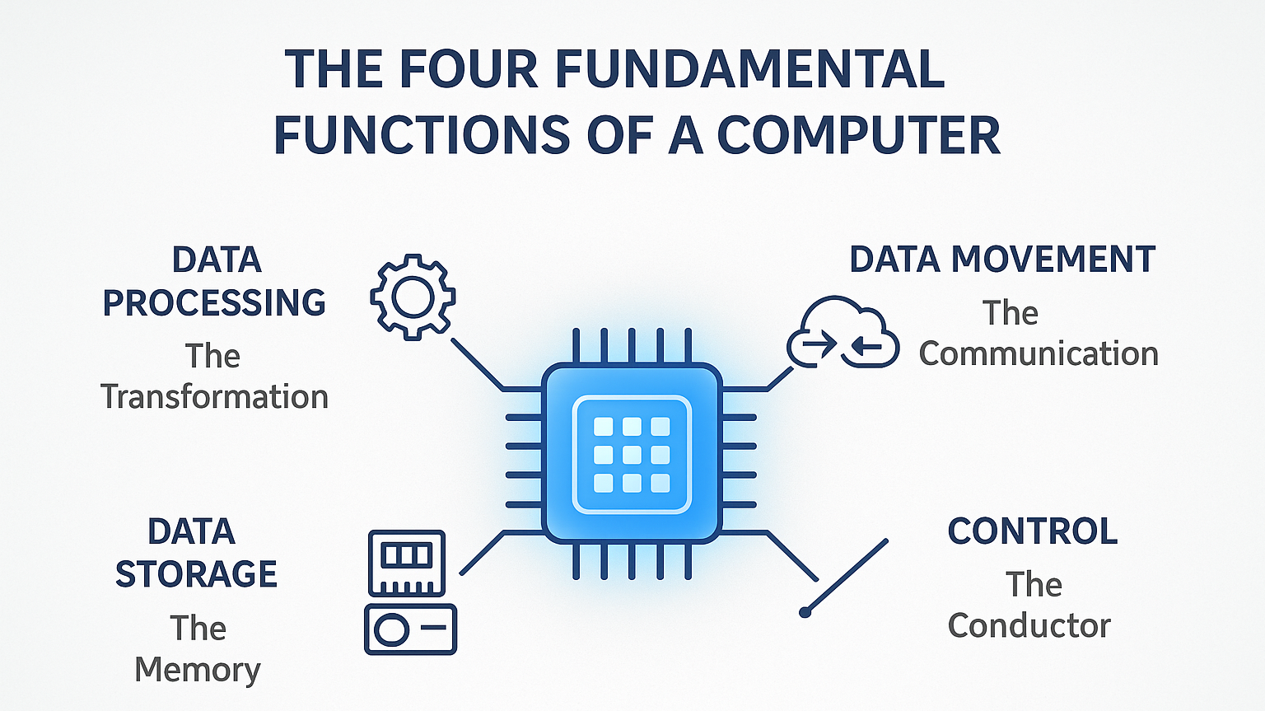

Slide 16
Functions : There are only four basic functions that a computer can perform:
Data processing:
  Raw input data is converted into meaningful output.
Data storage:
  Data come in and get processed, and the results go out immediately, the computer must temporarily store at least those pieces of data. Thus, there is at least a short-term data storage function.
  Equally important, the computer performs a long-term data storage function.
  Files of data are stored on the computer for subsequent retrieval and update.
Data movement:
  When data are received from or delivered to a device that is directly connected to the computer, the process is known as input–output (I/O), and the device is referred to as a peripheral.
  When data are moved over longer distances, to or from a remote device, the process is known as data communications.
Control:
  Within the computer, a control unit manages the computer’s resources and orchestrates the performance of its functional parts in response to instructions.

Slide 17
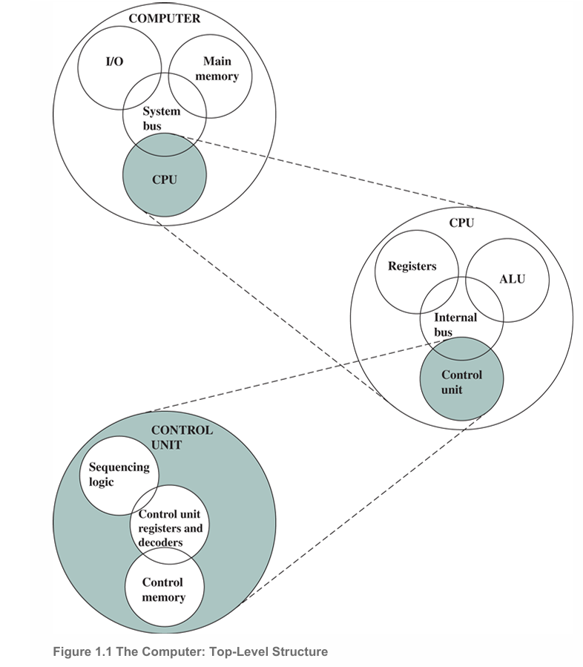
Structure
4 structural components
Central processing unit (CPU): Controls the operation of the computer and performs its data processing functions; often simply referred to as processor
Main memory: Stores data. .
I/O: Moves data between the computer and its external environment.
System interconnection: Some mechanism that provides for communication among CPU, main memory, and I/O. A common example of system interconnection is by means of a system bus consisting of a number of conducting wires to which all the other components attach.

Slide 19
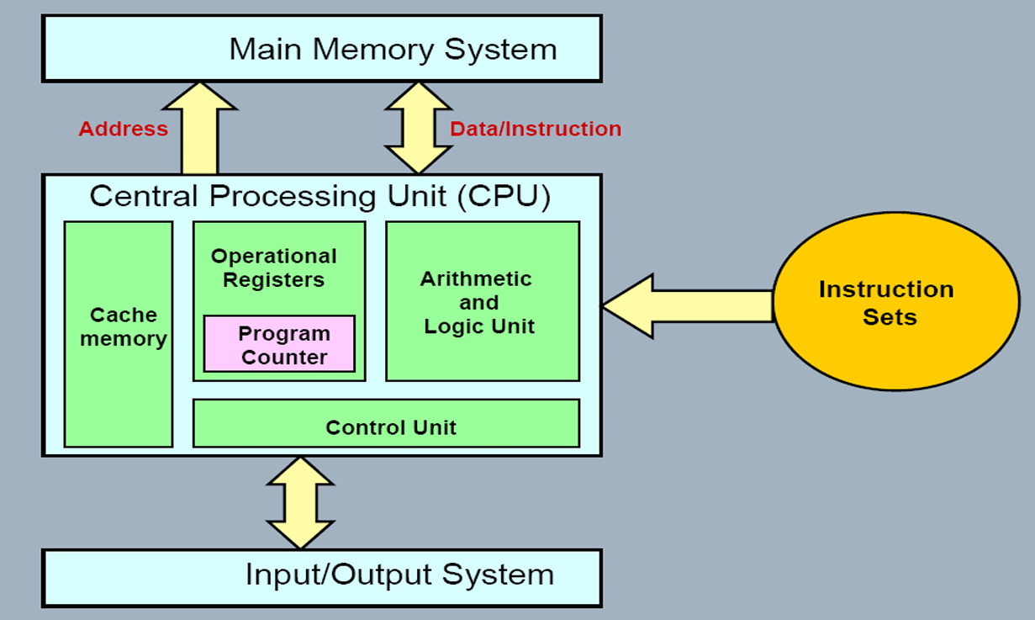
FUNCTIONAL UNITS
A computer consists of five functionally independent main parts:
  input,
  memory,
  arithmetic and logic,
  output, and
  control units

Slide 20
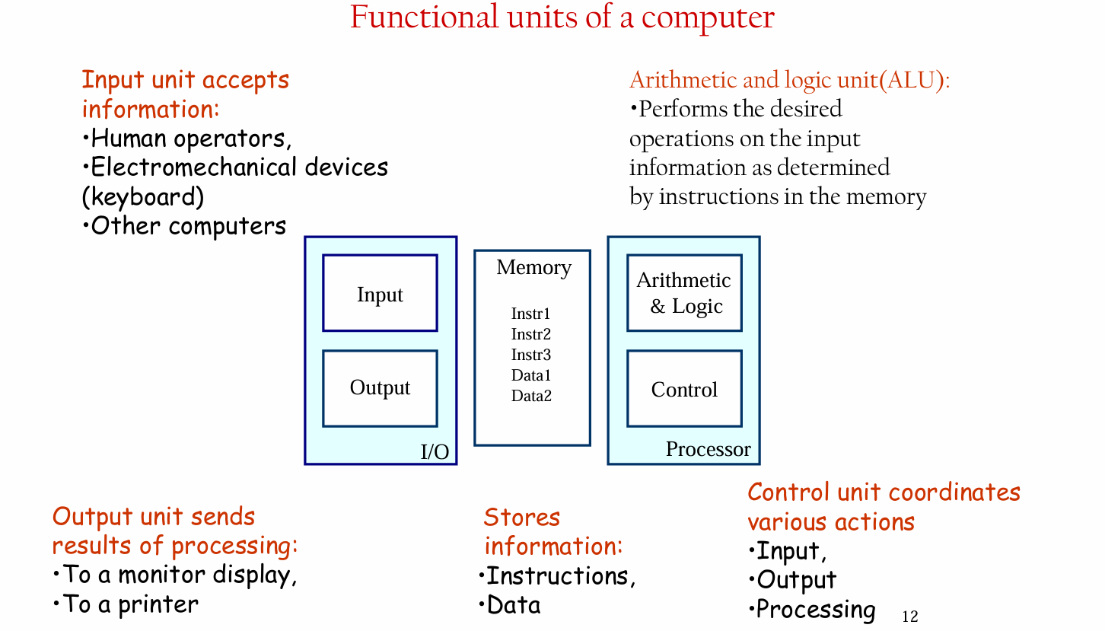

Slide 21
Two Types of Computer Information
Instructions (Programs)
Explicit commands that control computer operations
Two main functions:
Govern transfer of information (within computer & to I/O devices)
Specify arithmetic/logic operations to be performed
Program = A list of instructions performing a task
Stored in memory
Processor fetches and executes them sequentially
Data
Numbers and characters used as operands by instructions
Also stored in memory
Processed according to instruction commands

Slide 22
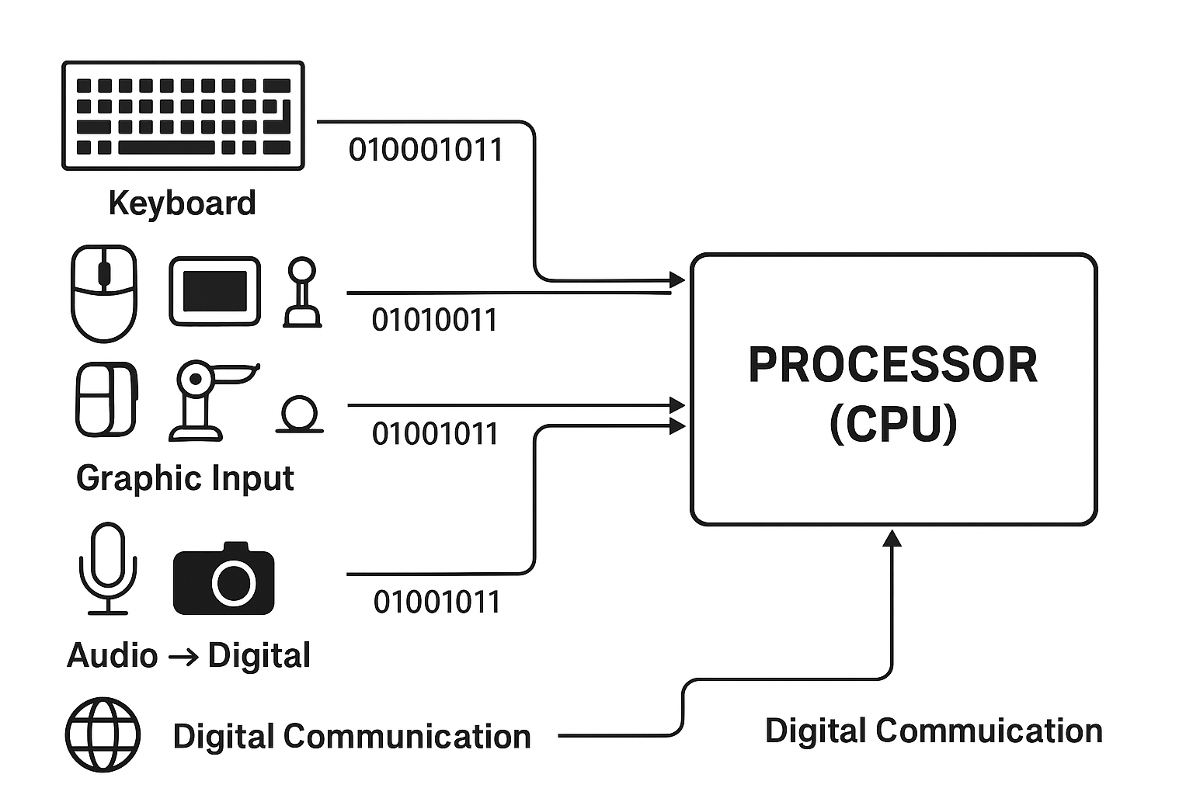
Input Unit : The Input Unit is the part of a computer system that accepts coded information from external sources and converts it into a form the processor can understand.
..
Keyboard
Primary Function: Translates keystrokes into binary code
How it works: Each key press generates a specific binary pattern transmitted to the processor
Audio Input
Device: Microphone, for storage and processing of audio
Process: Captures sound → Sampling → Conversion to digital code
Network Input
Source: Internet, other computers, database servers
Channel: Digital communication facilities
Purpose: Data transfer between systems

Slide 23
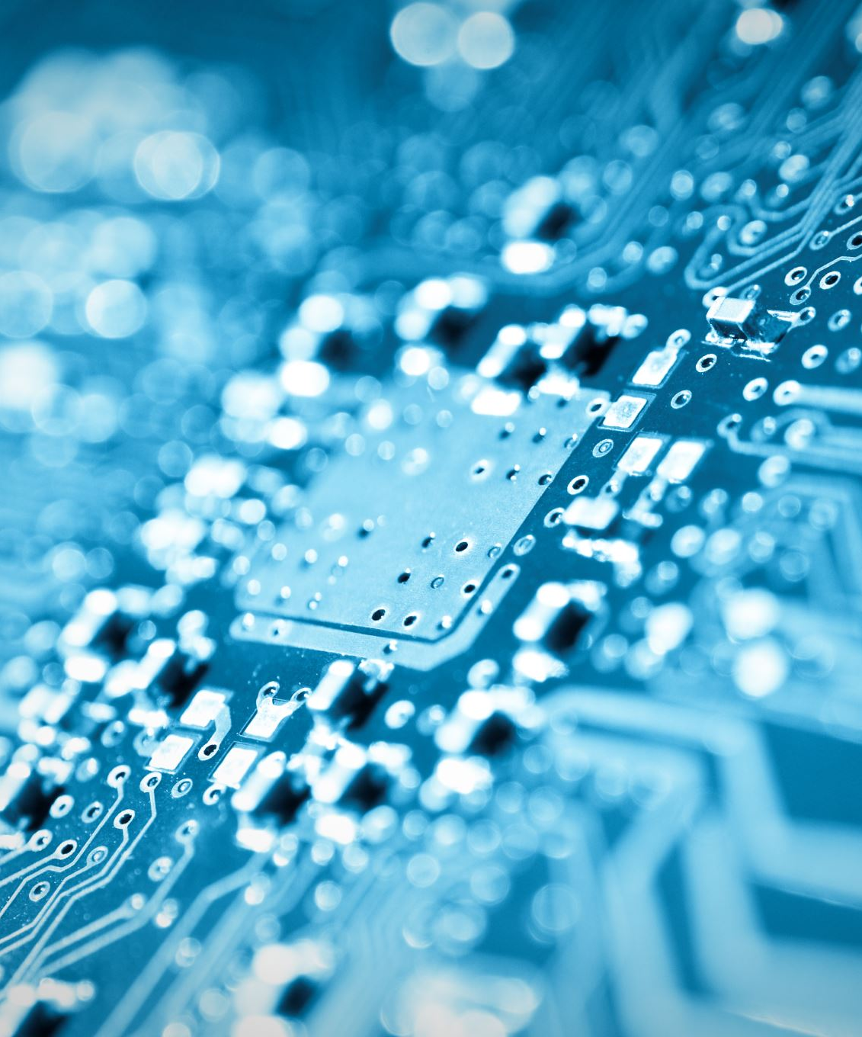
Memory Unit :
To store programs and data.
Primary
Secondary.
Primary Memory
Also called Main Memory or Primary Storage
Purpose: Fast, temporary storage for programs and data currently being executed by the processor
Key characteristic: Operates at electronic speeds (much faster than secondary storage)
Basic Building Block
Made of semiconductor storage cells
Each cell stores 1 bit (binary digit: 0 or 1)

Slide 24
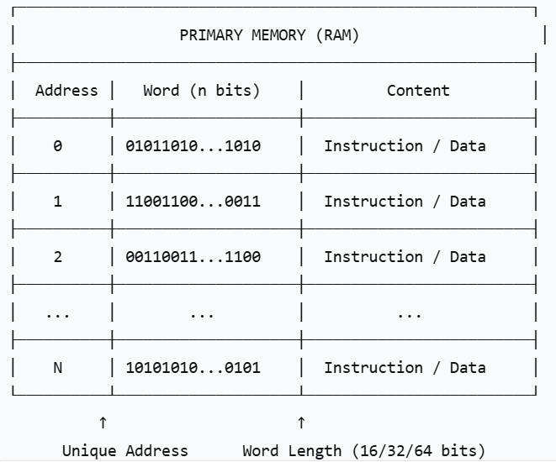
Grouping into Words
Cells are rarely accessed individually
Grouped into fixed-size words
Word: Smallest addressable unit for storage/retrieval in one operation
Word length: Number of bits per word (typically 16, 32, or 64 bits in modern computers)
Addressability
Each word has a unique address
Addresses are consecutive numbers starting from 0
Access method: Specify address + issue control command
The time required to access one word is called the memory access time.
This time is independent of the location of the word being accessed (upto about 100 ns for current RAM units.).

Slide 26
Cache Memory
As an adjunct to the main memory, a smaller, faster RAM unit, called a cache, is used to hold sections of a program that are currently being executed, along with any associated data.
The cache is tightly coupled with the processor and is usually contained on the same integrated-circuit chip.
The purpose of the cache is to facilitate high instruction execution rates.

Slide 27
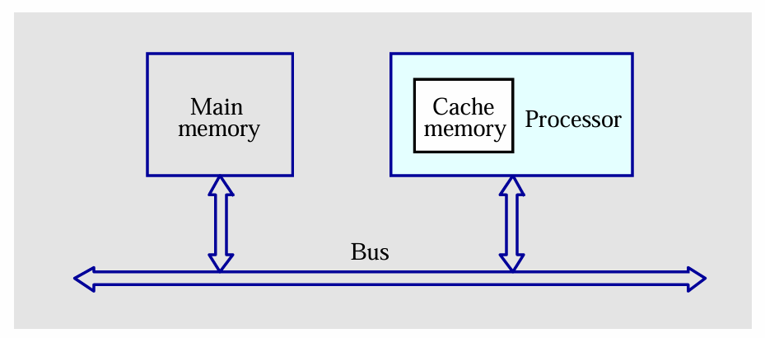
At the start of program execution, the cache is empty.
All program instructions and any required data are stored in the main memory.
As execution proceeds, instructions are fetched into the processor chip, and a copy of each is placed in the cache.
When the execution of an instruction requires data located in the main memory, the data are fetched, and copies are also placed in the cache.

Slide 28
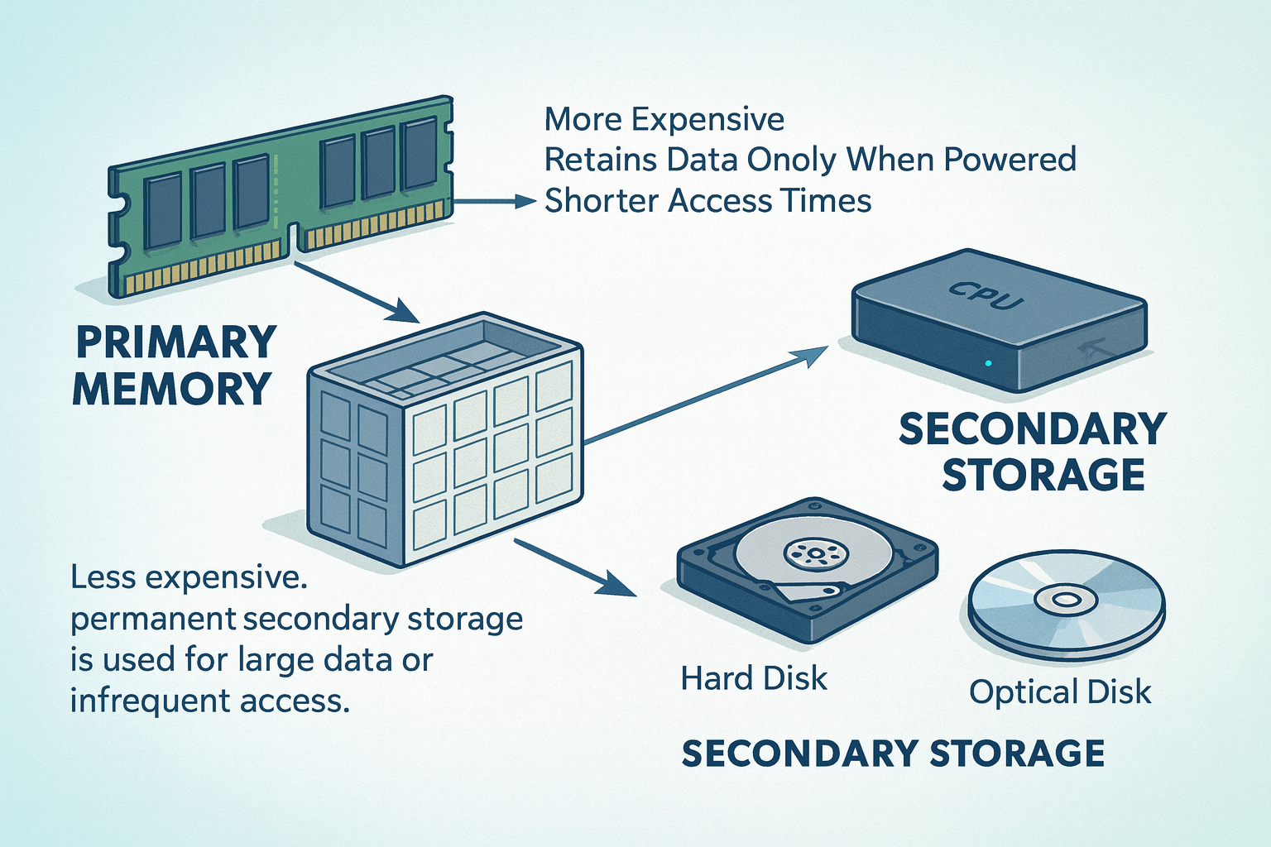
Secondary Storage
Although primary memory is essential, it tends to be expensive and does not retain information when power is turned off (Volatile).
Less expensive, permanent secondary storage is used when large amounts of data and many programs have to be stored, particularly for information that is accessed infrequently.
Access times for secondary storage are longer than for primary memory.
Magnetic disks, optical disks (DVD and CD), and flash memory devices.

Slide 29
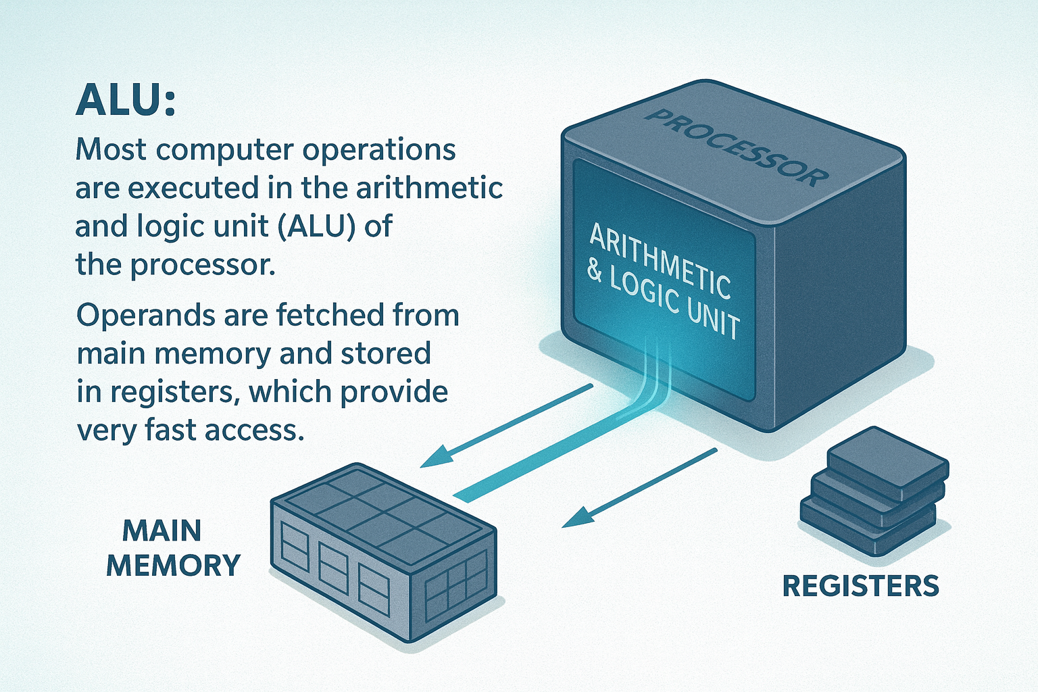
Arithmetic and Logic Unit
For example, if two numbers located in the memory are to be added, they are brought into the processor, and the addition is carried out by the ALU. The sum may then be stored in the memory or retained in the processor for immediate use.
When operands are brought into the processor, they are stored in high-speed storage elements called registers.
Each register can store one word of data.
Access times to registers are even shorter than access times to the cache unit on the processor chip.

Slide 30
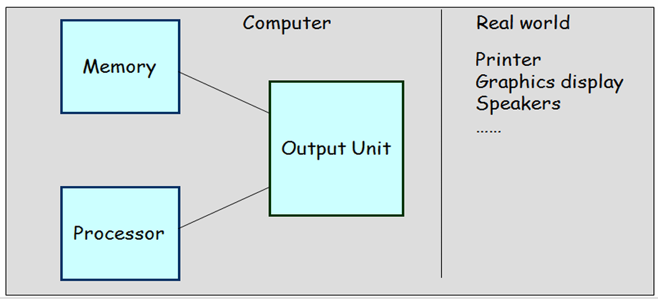
Output Unit
Computers represent information in a specific binary form.
Output units:-
Interface with output devices
Accept processed results provided by the computer in specific binary form
Convert the information in binary form to a form understood by an output device.

Slide 31
Control Unit
The memory, arithmetic and logic, and I/O units store and process information and perform input and output operations.
The operation of these units must be coordinated in some way.
This is the responsibility of the control unit.
The control unit is effectively the nerve center that sends control signals to other units and senses their states.
Instructions control “what” operations take place (e.g. data transfer, processing).
Control unit generates timing signals which determines “when” a particular operation takes place.

Slide 32
Thankyou

